Slide 1
WEEK 2 : FEATURE ENGINEERING , FEATURE SELECTION
ISHAN BORKER

Slide 2
CONETENTS
Feature Engineering
Definition
Data Transformation
One Hot Encoding
Label Encoding
Feature Scaling, Normalization
Feature Selection
Definition
Filter Methods
Types of Filer Methods
Wrapper Methods
Types of Wrapper Methods
Embedded Methods
Types of Embedded Methods

Slide 3
FEATURE ENGINEERING
Pre-processing step which is used to transform raw data into features that can be used for creating a predictive model using Machine Learning or Statistical Modelling
Feature engineering is important since it influences how machine learning models perform and help to figure out the hidden patterns in the data
Data Transformation
It is done because it can be used as a classifier for a simple binary model that identifies any attack
Since it is binary classification problem, perform transformation on class label and encode 'normal' as 0 and 'anomaly' as 1
After generating the new feature, we compute the cross tabulation on different categorical variables
Cross tabulation help to display the frequency distribution of categorical variables
It helps in exploring relationships and patterns between two or more categorical variables
It also provides valuable insights for making data-driven decisions

Slide 4
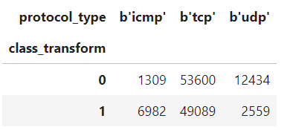
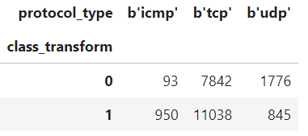
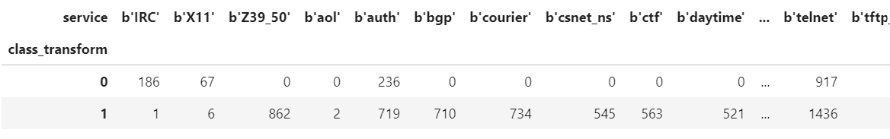
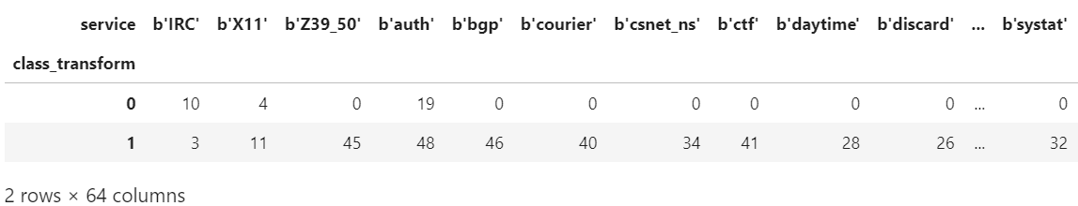
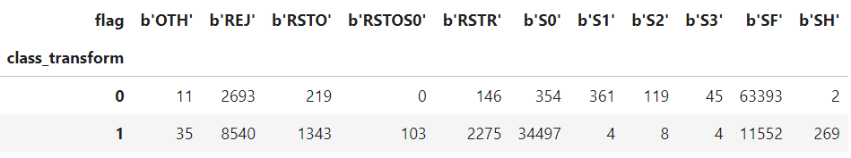
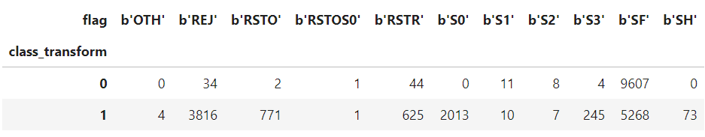
Results of different categorical variables on both the datasets
Train Dataset
Test Dataset

Slide 5
One-Hot Encoding and Label Encoding
One Hot Encoding:
Defined as a process of transforming categorical variables into numerical features that can be used as input to Machine Learning
Can reduce bias, improve accuracy and interpretability
Converting categorical variables into dummy variables
Label Encoding:
Used to convert categorical columns into numerical ones so that they can be fitted by machine learning models which only take numerical data
Simplifies the data, reduces the memory usage, makes it flexible during data preprocessing

Slide 6
Feature Scaling and Normalization
Variables present in the dataset are measure at different scales and do not contribute equally to the fit of the model which creates a bias
So, to deal with this problem standard scalar is used
Feature scaling → data preprocessing technique used to transform the values of features in a dataset to a similar scale.
Purpose → ensure that all features contribute equally to the model and to avoid the domination of features with larger values
Normalization → data preprocessing technique used to adjust the values of features in a dataset to a common scale
Done to reduce the impact of different scales on the accuracy of machine learning models

Slide 7
Feature Selection
Way of selecting the subset of the most relevant features from the original features set by removing the redundant, irrelevant, or noisy features
Filter Methods: features are selected on the basis of statistics measures
Numerical Input, Categorical Output:
Feature selection classification problem with numerical input variables using a correlation coefficient, with the categorical target
Pearson's correlation coefficient:
Used to summarize the strength of the linear relationship between two data samples
Is a measure of quantifying the association between the two continuous variables and the direction of the relationship with its values ranging from -1 to 1

Slide 8
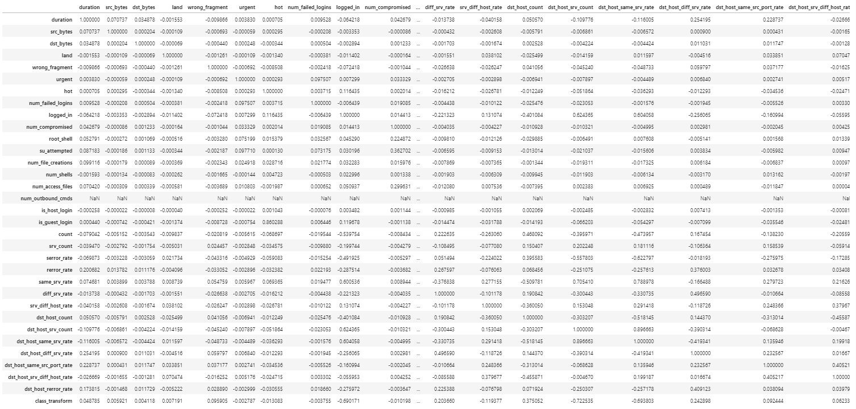
Results of Pearson Correlation Coefficient

Slide 9
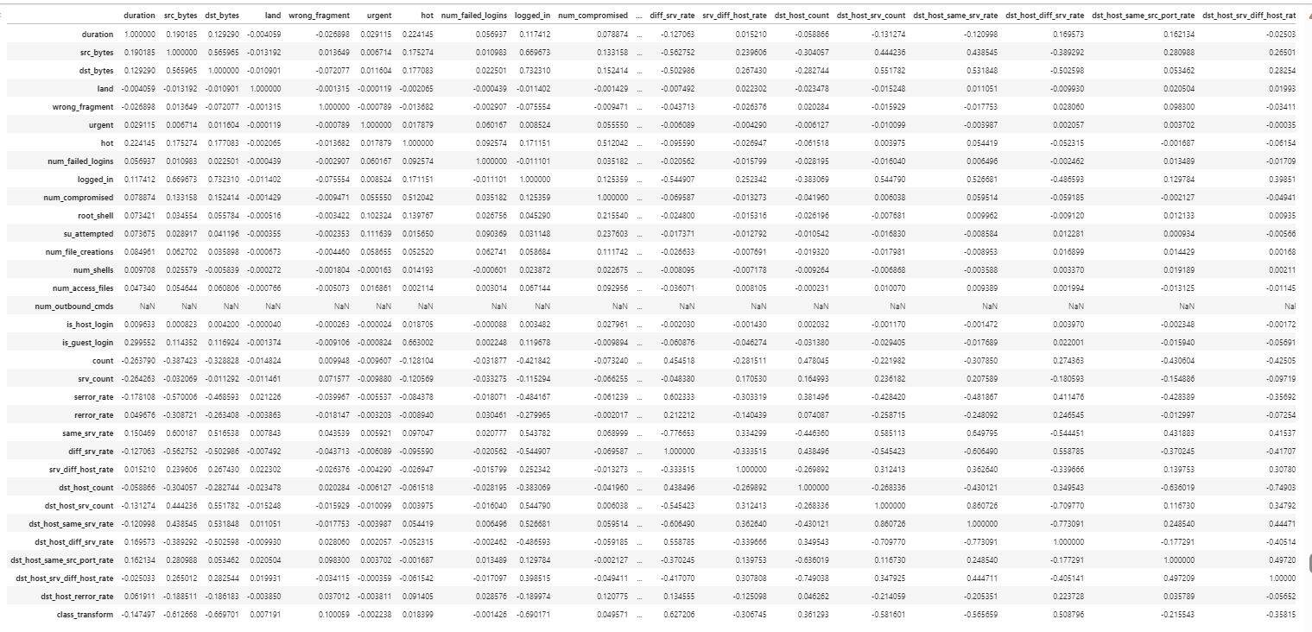
Kendall's correlation:
Used to measure the ordinal association between two measured quantities and used when data doesn’t meet one of the requirements of Pearson’s correlation
Kendall correlation between two variables will be high when observations have a similar (or identical for a correlation of 1) rank (i.e., relative position label of the observations within the variable: 1st, 2nd, 3rd, etc.) between the two variables, and low when observations have a dissimilar (or fully different for a correlation of −1) rank between the two variables

Slide 10
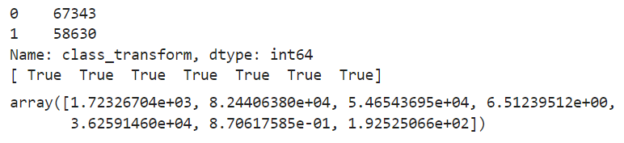
Categorical Input, Categorical Output:
Classification predictive modeling problem with categorical input variables
Can use a correlation coefficient, such as Chi-Squared test (contingency tables) or Mutual Information
Chi-squared test:
Statistical method that can be used for feature selection in machine learning
Used because it checks how well the observed values for a given distribution fit with it when the variables are independent
Used to determine whether there is a significant association between two categorical variables
In this problem, we select we only consider categorical variables as input and keep class_transform as target
Then we use SelectKBest algorithm with number of top features to select
It finds the mask of the selected features and the respective scores
We see in the picture that the values of selected features along with their respective scores

Slide 11
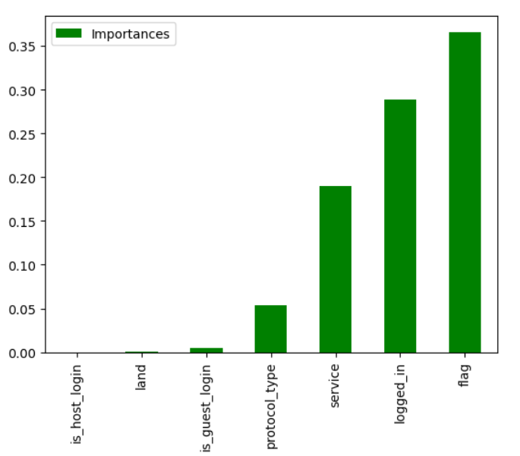
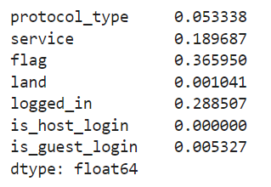
Information Gain/Mutual Information:
Measures the reduction in entropy or surprise by splitting a dataset according to a given value of a random variable
Helps to decide whether a feature should be used to split a node or not
Mutual information is calculated between two variables and measures the reduction in uncertainty for one variable given a known value of the other variable
Here we use mutual_info_classif to generate feature importance for all the input variables which we selected
Plot the feature importance using bar plot

Slide 12
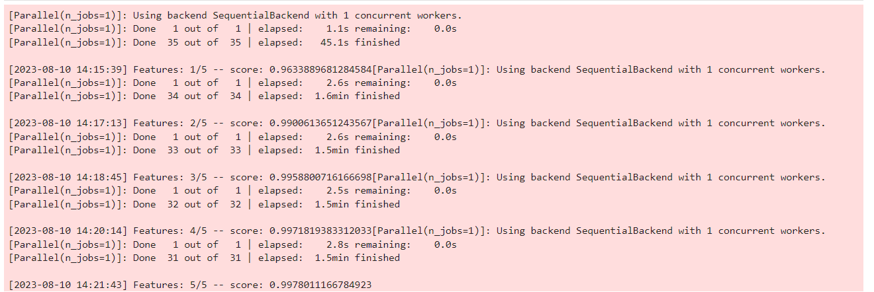
Wrapper Methods
Selection of features is done by considering it as a search problem, in which different combinations are made, evaluated, and compared with other combinations
Forward Feature Selection:
Forward selection is an iterative process, which begins with an empty set of features
Used to identify the most relevant variables for predictive modeling
After each iteration, it keeps adding on a feature and evaluates the performance to check whether it is improving the performance or not
Process continues until the addition of a new variable/feature does not improve the performance of the model
Here we use the train dataset for specifying input and target variables
Random Forest Classifier is used for feature selection
Sequential Feature Selector is used with parameters like forward=True, scoring=’accuracy’, cv=5, verbose=2, k_features=5, etc.

Slide 13
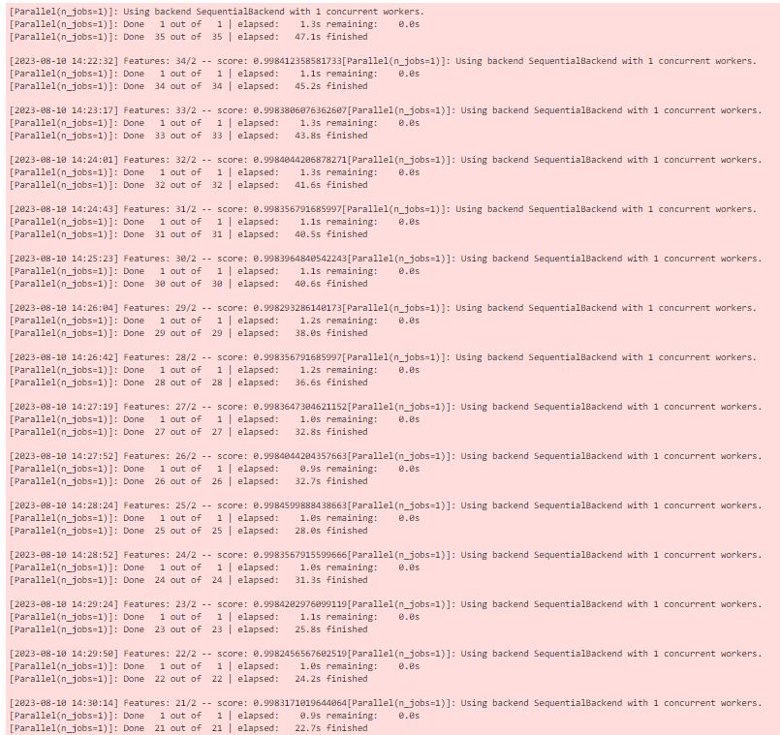
Backward Elimination:
Opposite of forward selection. It finds the best subset of features from a given set of features
This technique begins the process by considering all the features and removes the least significant feature
Elimination process continues until removing the features does not improve the performance of the model
Here, we use the train dataset for specifying input and target variables
Random Forest Classifier is used for feature selection
Sequential Feature Selector is used with parameters like forward=False, scoring=’accuracy’, cv=5, verbose=2, k_features=5, etc.

Slide 14
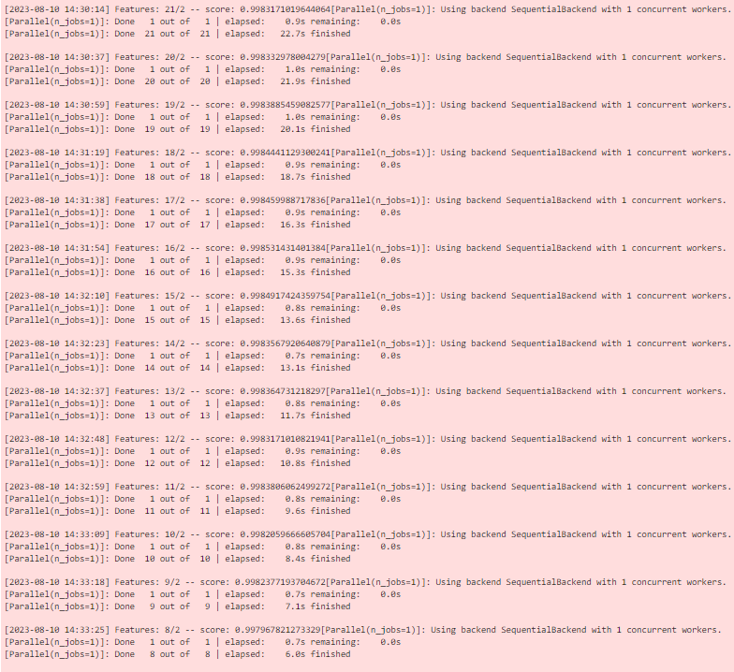
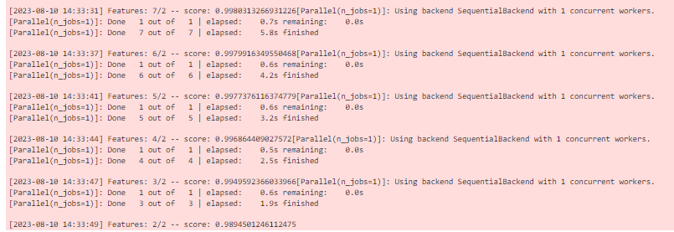

Slide 15
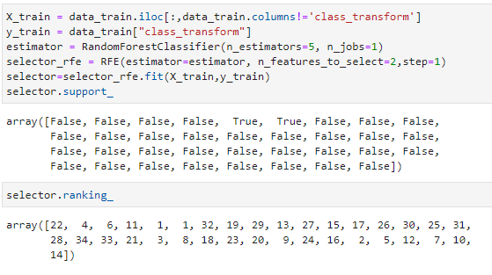
Recursive feature elimination:
Is a recursive greedy optimization approach, where features are selected by recursively taking a smaller and smaller subset of features
RFE avoids overfitting by cross-validation during the feature selection process
Here we use the train dataset for specifying input and target variables
Random Forest Classifier is used for feature selection
RFE is used with parameters like estimator, n_features_to_select=2, step=1, etc.

Slide 16
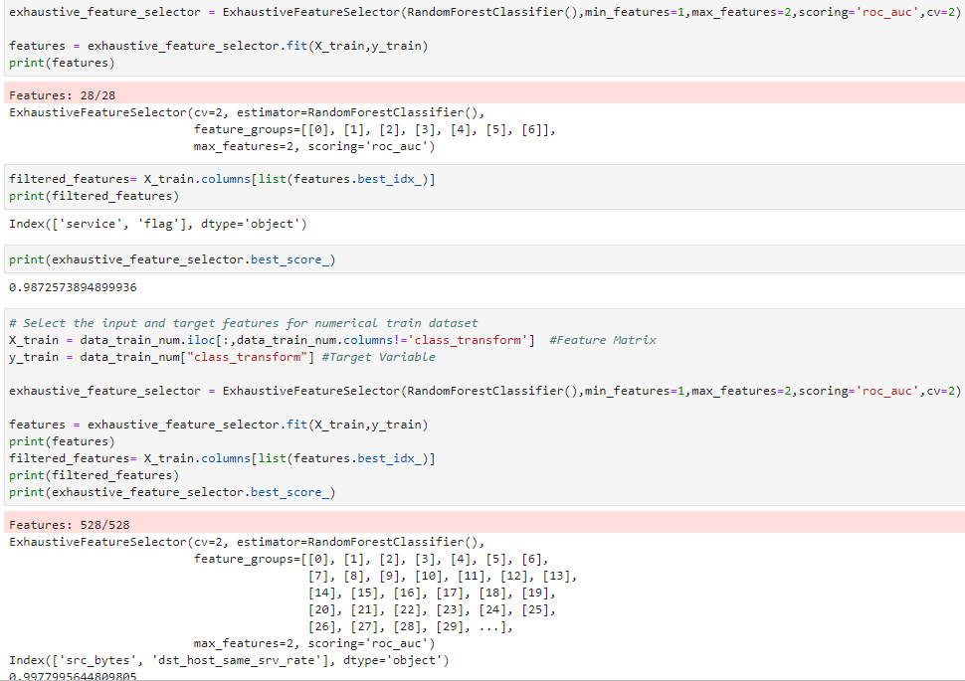
Exhaustive feature selection:
The performance of a ML algorithm is evaluated against all possible combinations of the features
The feature subset that yields best performance is selected
The exhaustive search algorithm is the greedy algorithm of all the wrapper methods because it tries all the combination of features and selects the best
Used since it can go over all the possible feature combinations , pick up the model with the highest accuracy
Use the numerical and categorical train dataset for specifying input and target variables
ExhaustiveFeatureSelector () method is used with Random Forest Classifier model and parameters like min_features =1, max_features =2, cv=2, scoring=’roc_auc’, etc., filter the best features and calculate the best score

Slide 17
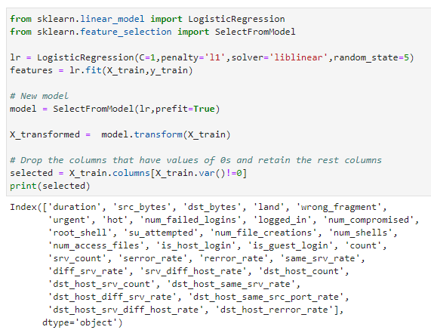
Embedded Methods
Has the benefits of both the wrapper and filter methods by including interactions of features but also maintain reasonable computational costs
Lasso Regularization (L1):
Adds a penalty to the different parameters of the machine learning model to reduce the freedom of the model
Shrinks some of the coefficients to zero and that feature can be removed from the model thereby avoiding the overfitting on the training data
It is preferred when we have many features as it provides sparse solutions
We use the logistic regression model with penalty=’l1’, solver=’liblinear’
Next, we choose SelectFromModel as a part of feature selection and include logistic regression
Transform the input variables. It retains certain features after removing the features with values as zeros

Slide 18
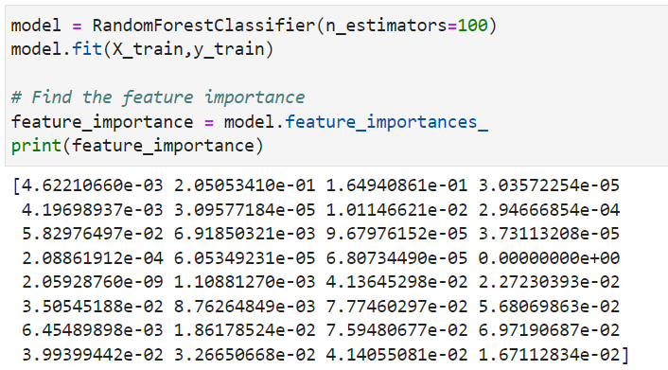
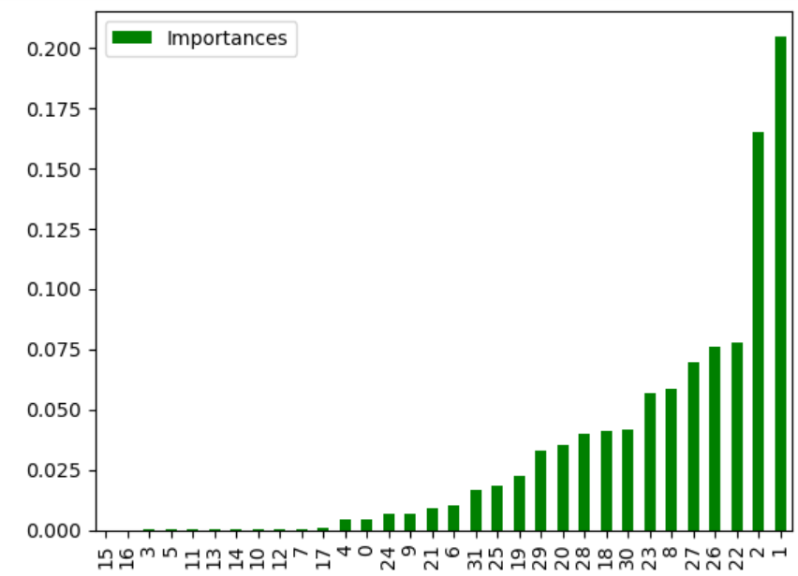
Random Forest Importance:
Tree-based strategy used by random forests rank by how well they improve the purity of the node
Reduces overfitting by averaging multiple decision trees and is less sensitive to noise and outliers in the data
Use the Random Forest classifier model and fit it on the input and target variables of the train dataset
Then we find the feature importance and visualize them in a bar plot

Slide 19



